Slide 1
CSE 216 E-commerce site
Prepared By: Farhan Tanvir Utshaw (1505105)
Masfiqur Rahaman (1505111)
Project Supervisor: Abida Sanjana
Lecturer, Department of CSE,
BUET

Slide 2
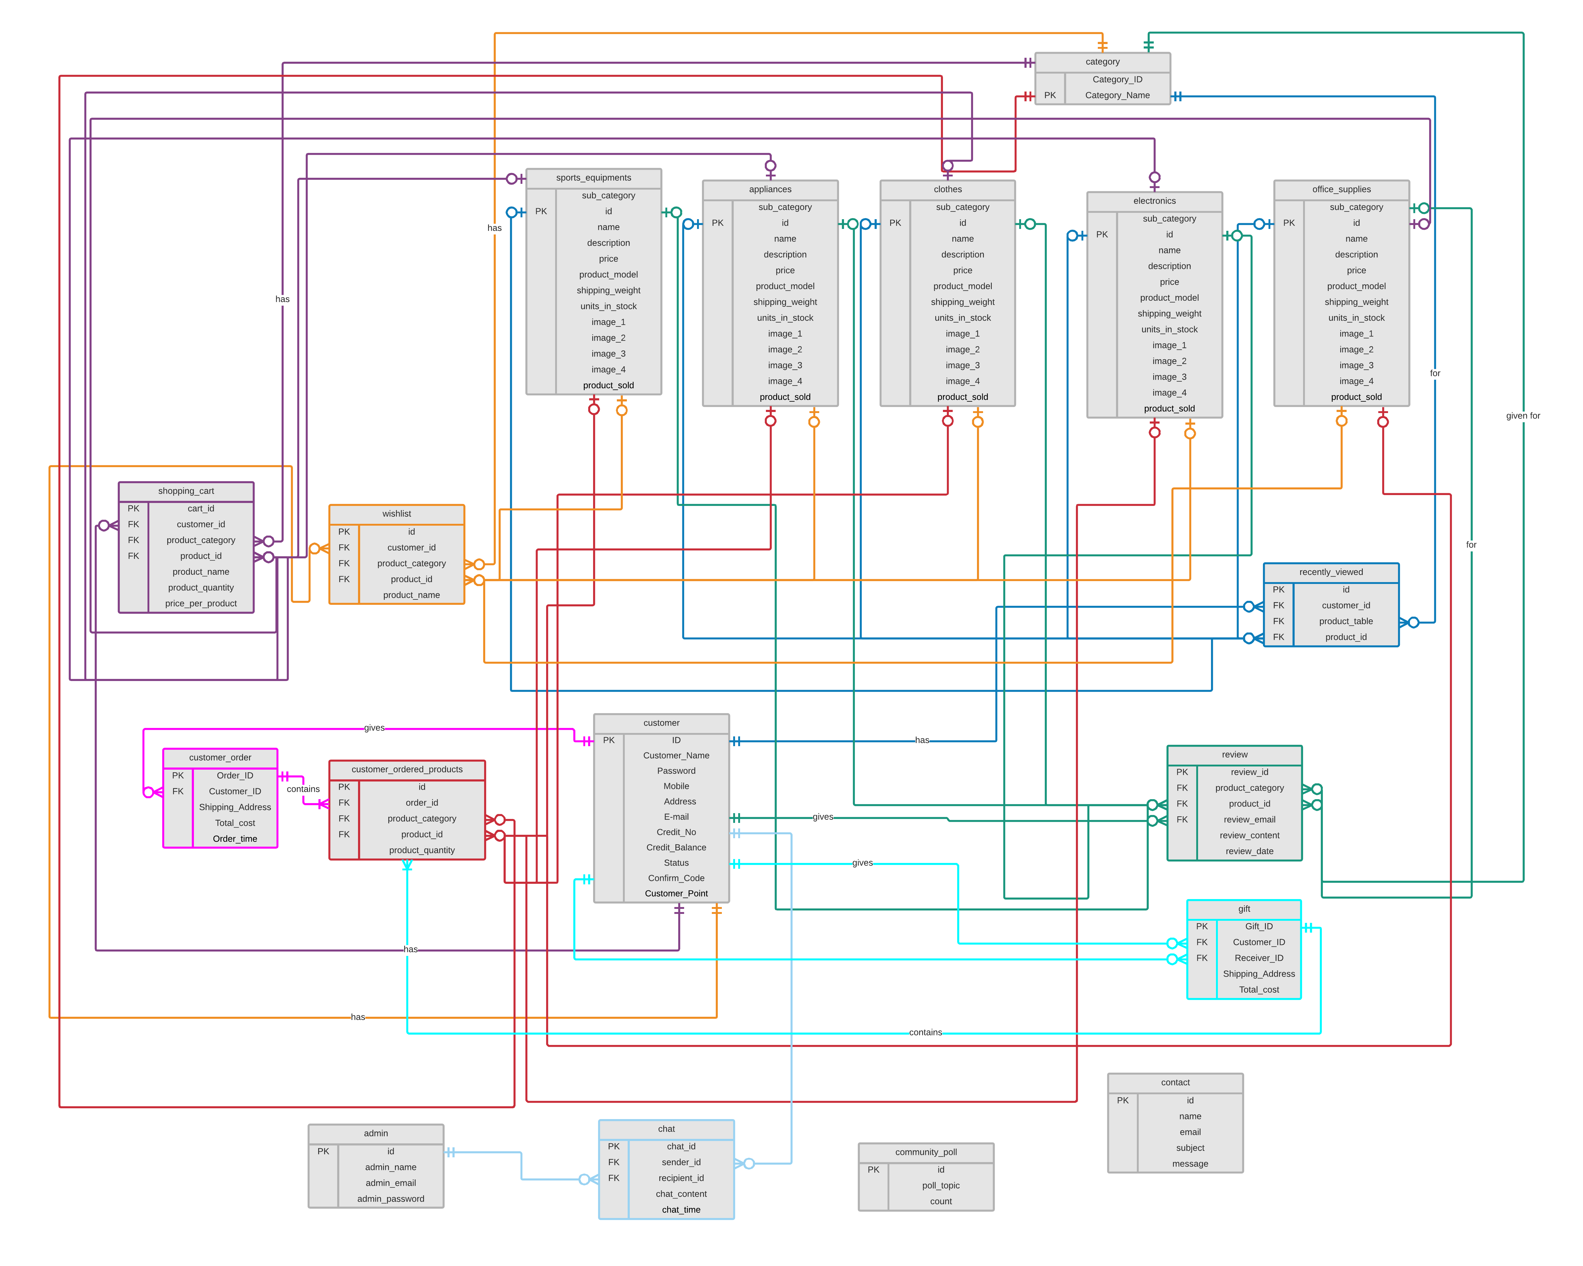

Slide 3
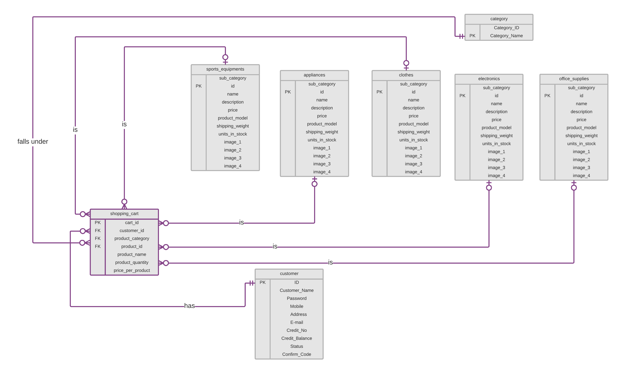
Verification of Email on Sign Up

Slide 4
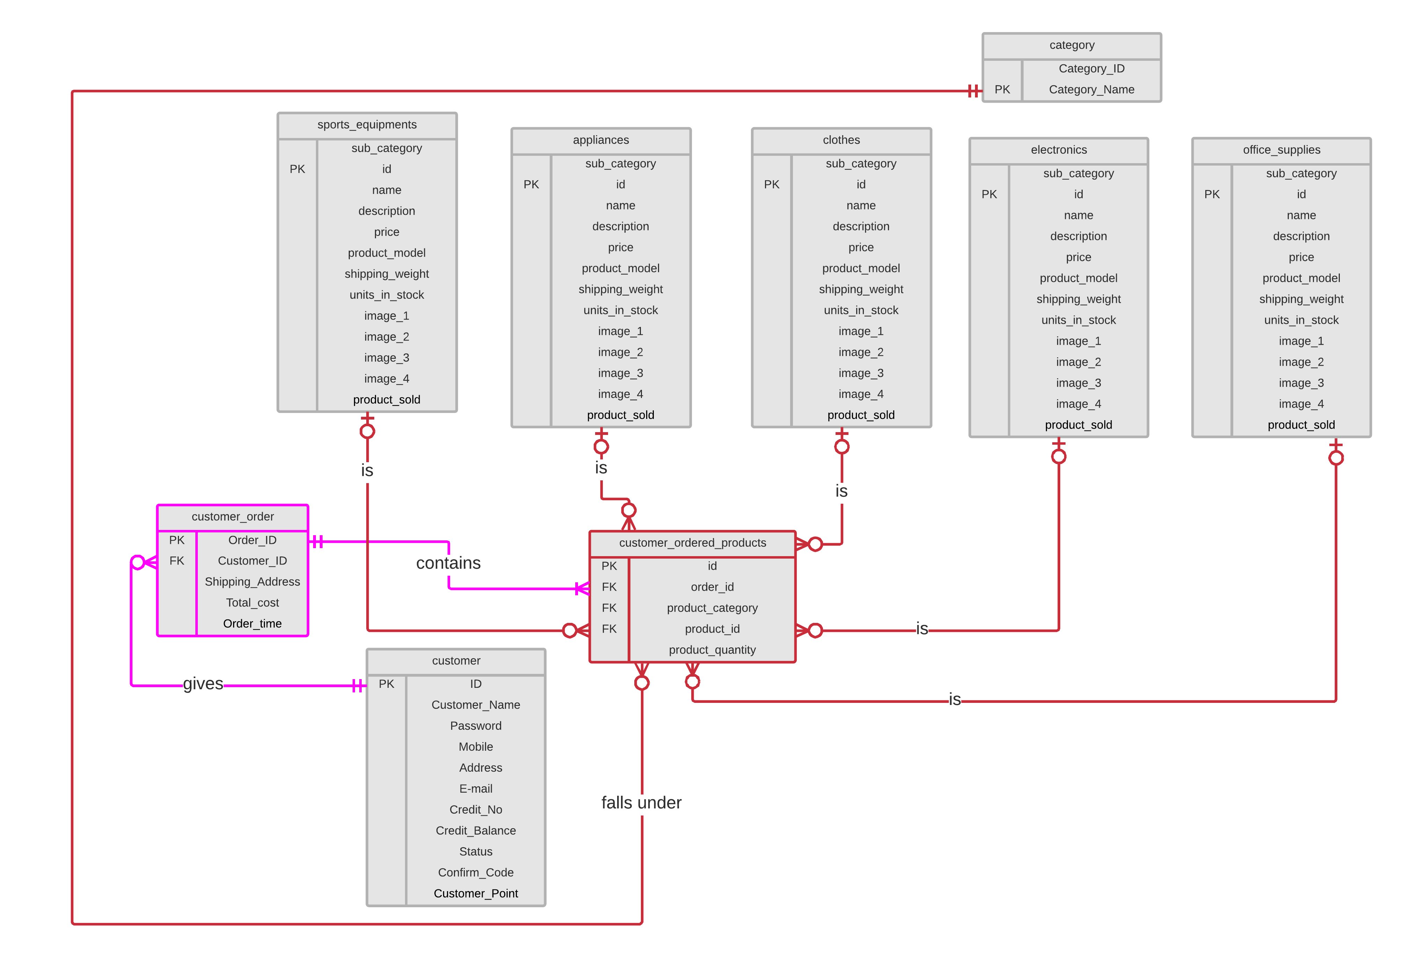
Verification of Email on Sign Up

Slide 5
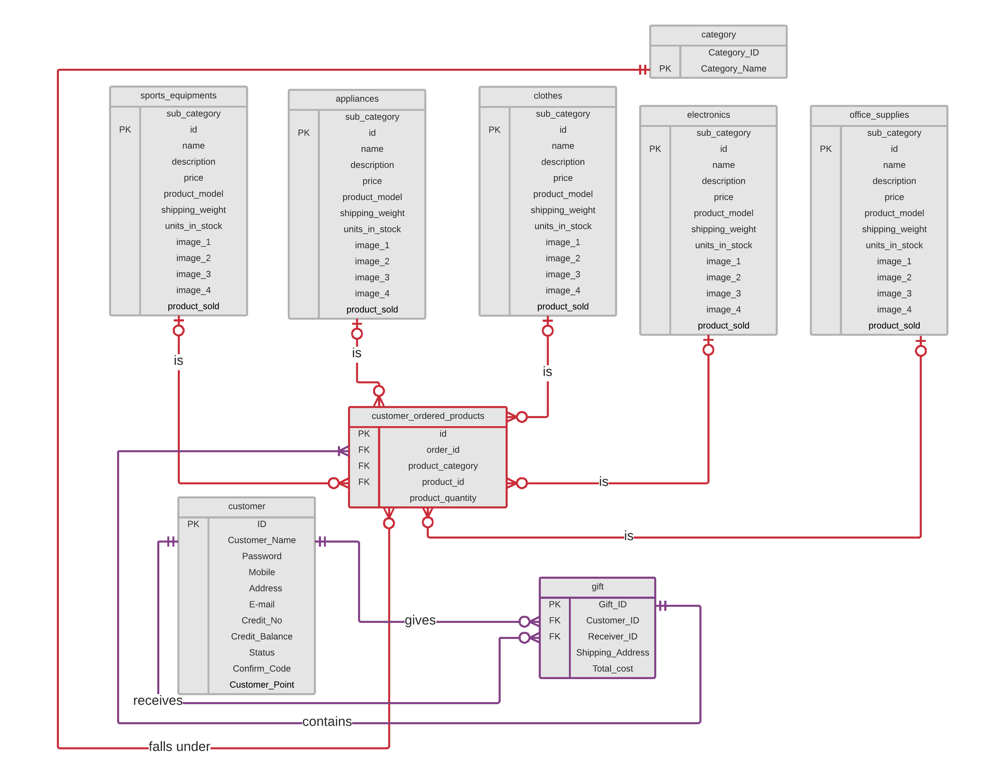
Verification of Email on Sign Up

Slide 6
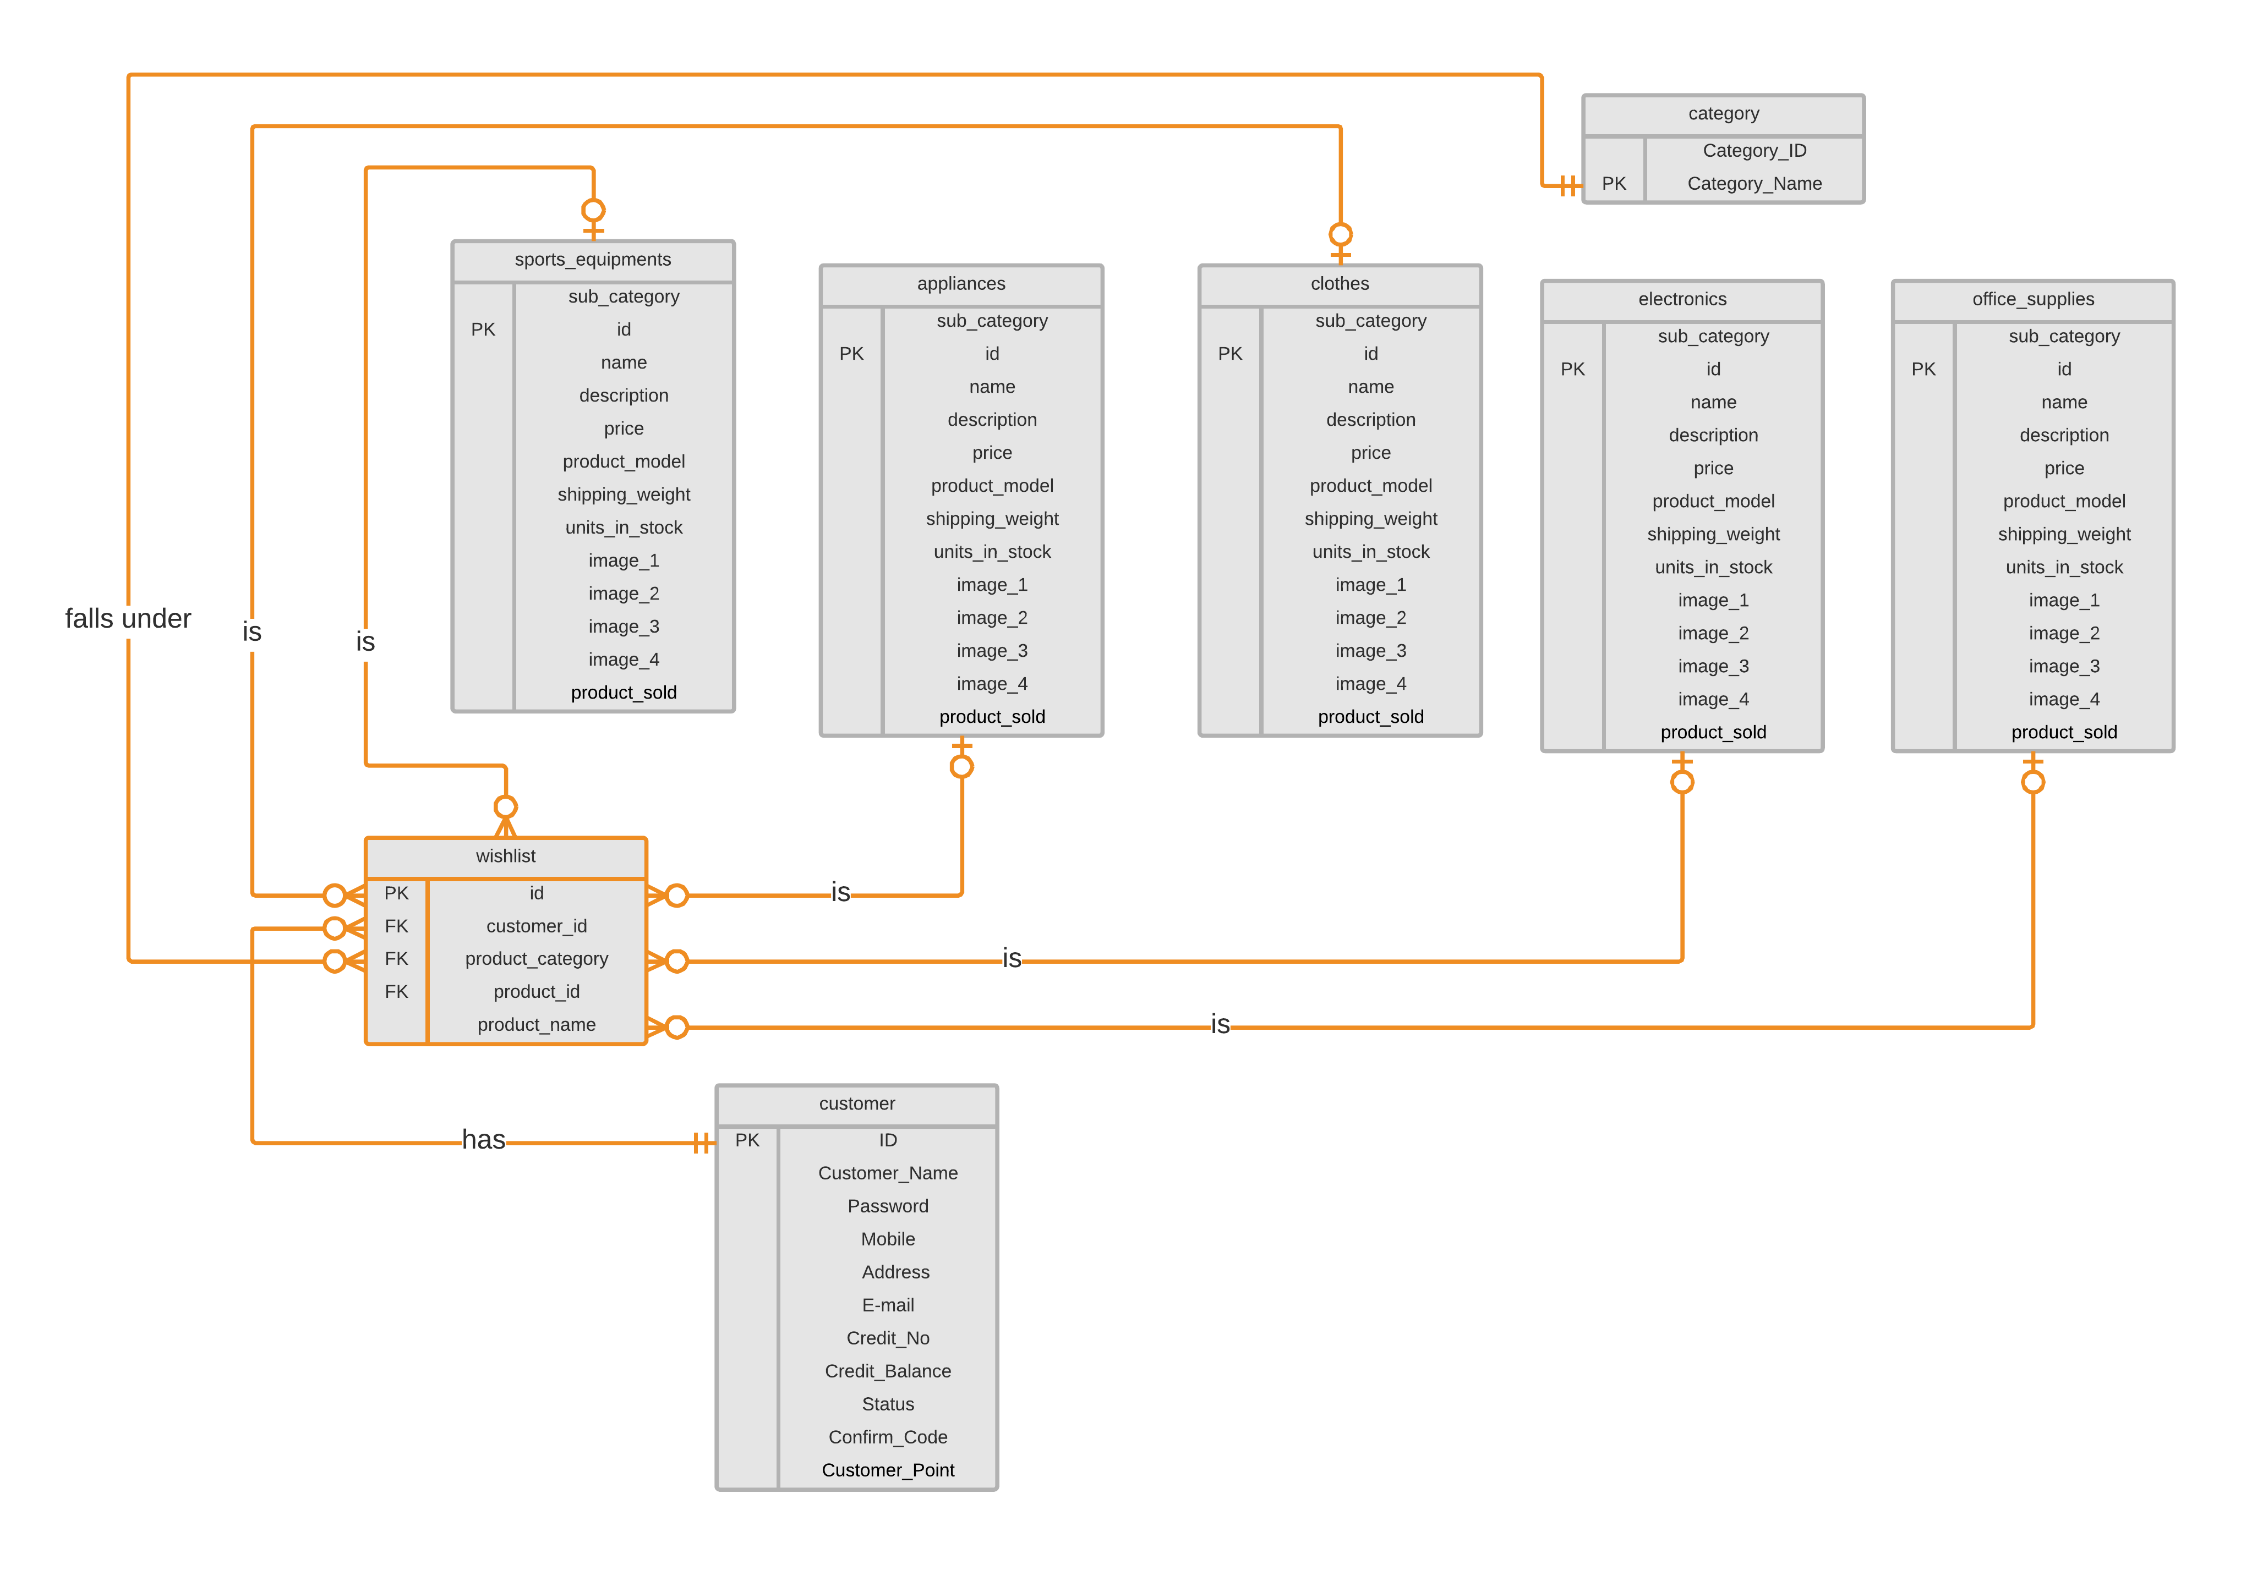
Verification of Email on Sign Up

Slide 7
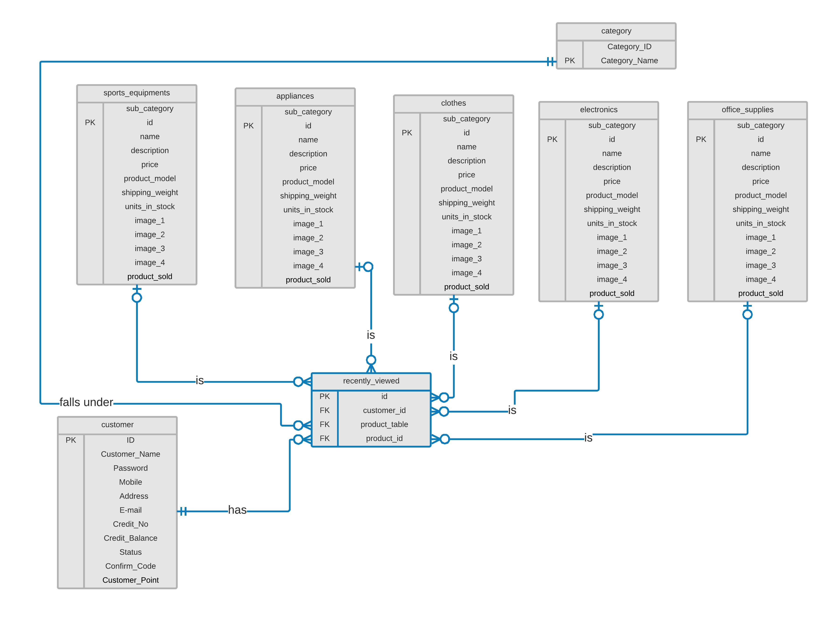
Verification of Email on Sign Up

Slide 8
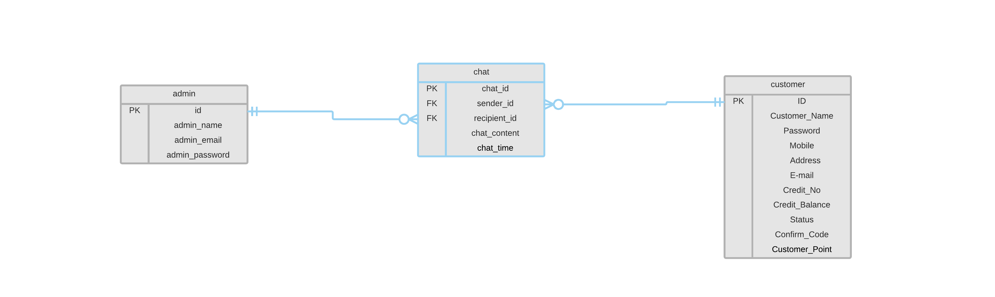
Verification of Email on Sign Up

Slide 9
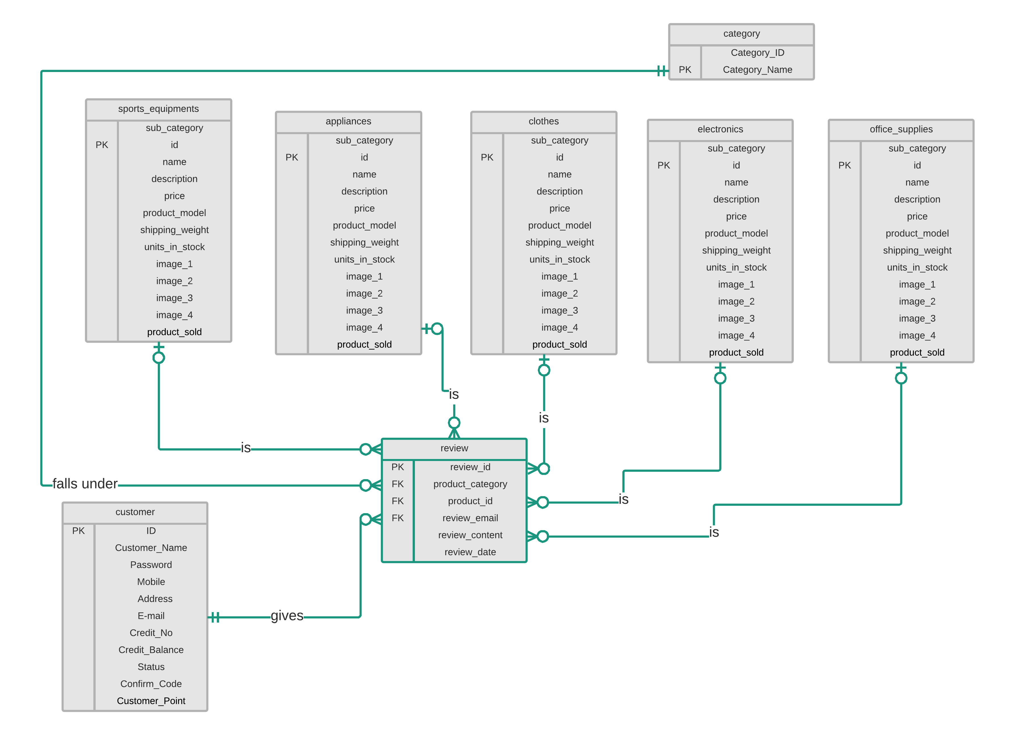
Verification of Email on Sign Up

Slide 10

Place your screenshot here

Slide 11
MANY THANKS!

